Slide 1
React Routing and Component Lifecycle Methods
Alind Kumar Jain - 326835
Shilpa Mandara – 716650
Jason Monroe - 688776

Slide 2
App Feature / Scenario
In our DevBios app, we would like for the Add Developer form and Displayed Bios to be on separate “pages” in our SPA. We would also like to connect to the live API. How can this be achieved?

Slide 3
Course Objective:
At the end this 120 min session, you will be able to
Implement routing in a React app
Use Component lifecycle methods to retrieve live data from an API

Slide 4
Benefits
Must-know for React development
Routing helps preserve state, browser history functionality
Lifecycle methods are key to getting “in the middle” of a page’s rendering so that asynchronous events can be orchestrated such as accessing an API and using the results

Slide 5
Key Topics
React Routing
Component Lifecycle Methods
Fetch

Slide 6
Routing in React JS

Slide 7
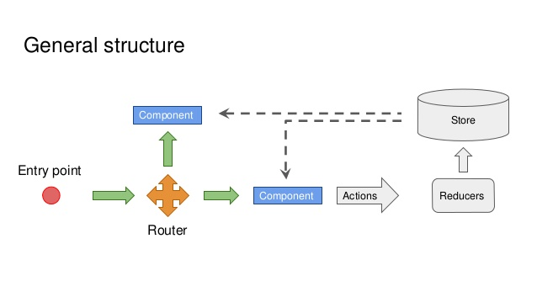
ROUTING
Routing or Navigation, is an integral and important part of any application.
It gives us the power of navigating from one page or screen to another.
This power is provided by React as well.
There are many ways for routing provided by React.
But the most important and used one is , REACT ROUTER.

Slide 8
Single Page Applications (SPA)
Web application or Web site that interacts with the user by dynamically rewriting the current page rather than loading entire new pages from a server.
So basically, all the code resources are dynamically loaded and added to the page as necessary, usually in response to user actions.
Route Config
External
Navigation
Location
Content
Browser History
Router
View
Internal Navigation

Slide 9
React Router
Since we are dealing with a SPA, you need a way to trigger the contents that are loaded on the screen.
React Router introduces a concept called “Dynamic Routing”, which is quite different from “Static Routing”.
When dealing with “Static Routing”, declare routes as part of app’s initialization before any rendering takes place (Rails, Express, Ember, Angular, and so on).
“Dynamic Routing” means that routing takes place as app is rendering, not in a configuration or convention outside of a running app.

Slide 10
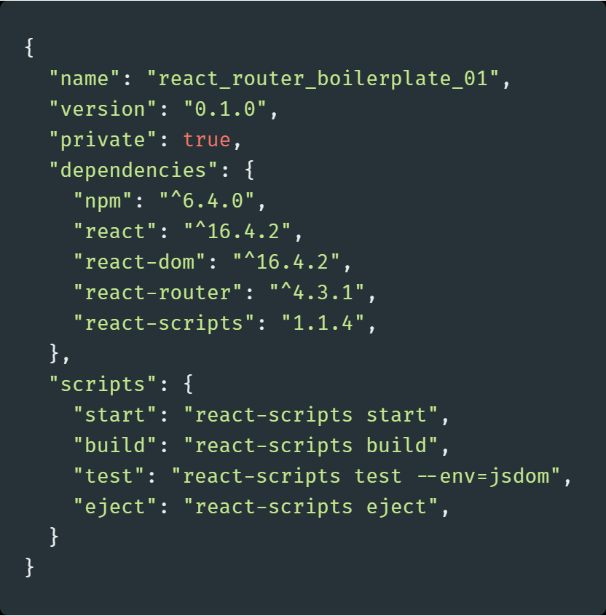
Setting Up React Router
Step-1
Install dependency
$ npm i react-router-dom
or
$ yarn add react-router-dom
After running either of these commands
react-router will be added to your package.json file
https://reacttraining.com/react-router/web/guides/quick-start

Slide 11
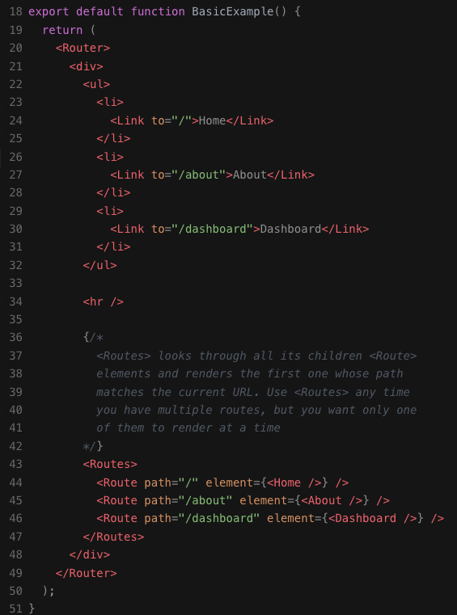
Routing Components
Router tag wraps routing system which includes defined route in Routes and Links to those routes
Link tag takes a ‘to’ property which identifies the url
Routes tag wraps all the routes that are defined
Each route will be identified in a <Route> component.
The <Route> tag will take a path property and an element property which identifies which component(s) to render
When a path matches the path given to the <Route> component, it will return the component it wraps
https://reacttraining.com/react-router/web/example/basic
https://reactrouter.com/docs/en/v6/upgrading/v5

Slide 12
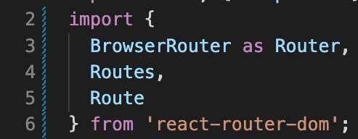
Routing Imports
Router (BrowserRouter), Routes, Link and Route come from react-router-dom (>=v6)

Slide 13
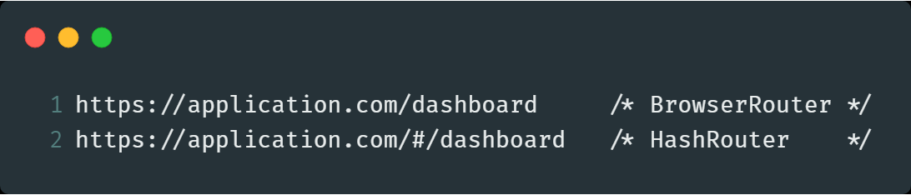
<HashRouter> Vs <BrowserRouter>
One builds classic URLs, the other builds URLs with the hash,as shown.
Which one to use basically depends on, which browser is in action.
<BrowserRouter> uses History API, which is not supported by IE9 and below.
The History API lets you interact with the browser history, trigger the browser navigation methods and change the address bar content.

Slide 14

Code Along Practice – Navbar for hello-react
Install routing in app (npm i react-router-dom)
Migrate App render to a new Home component
Create a new functional component called Navbar that contains a bootstrap navbar with <Link /> elements that navigate to each of the above Components.
Create routes for Home, DisplayBios and AddDeveloper inside of App.js

Slide 15
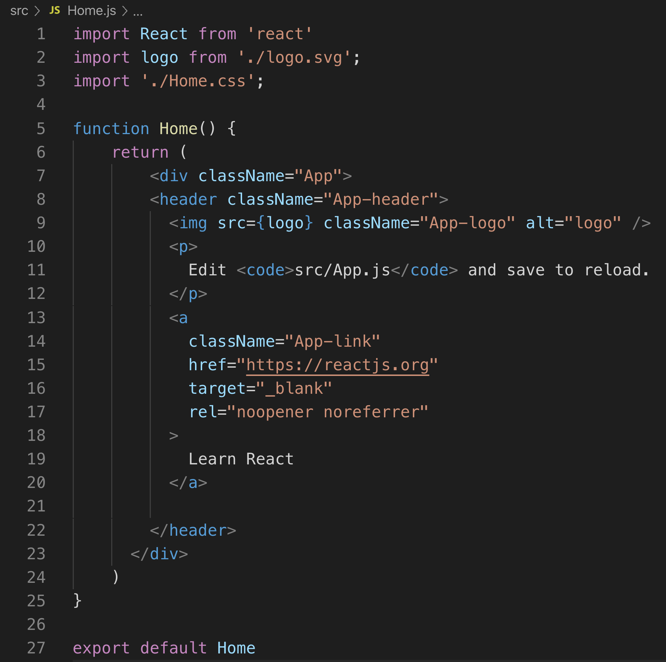
Home.js

Slide 16
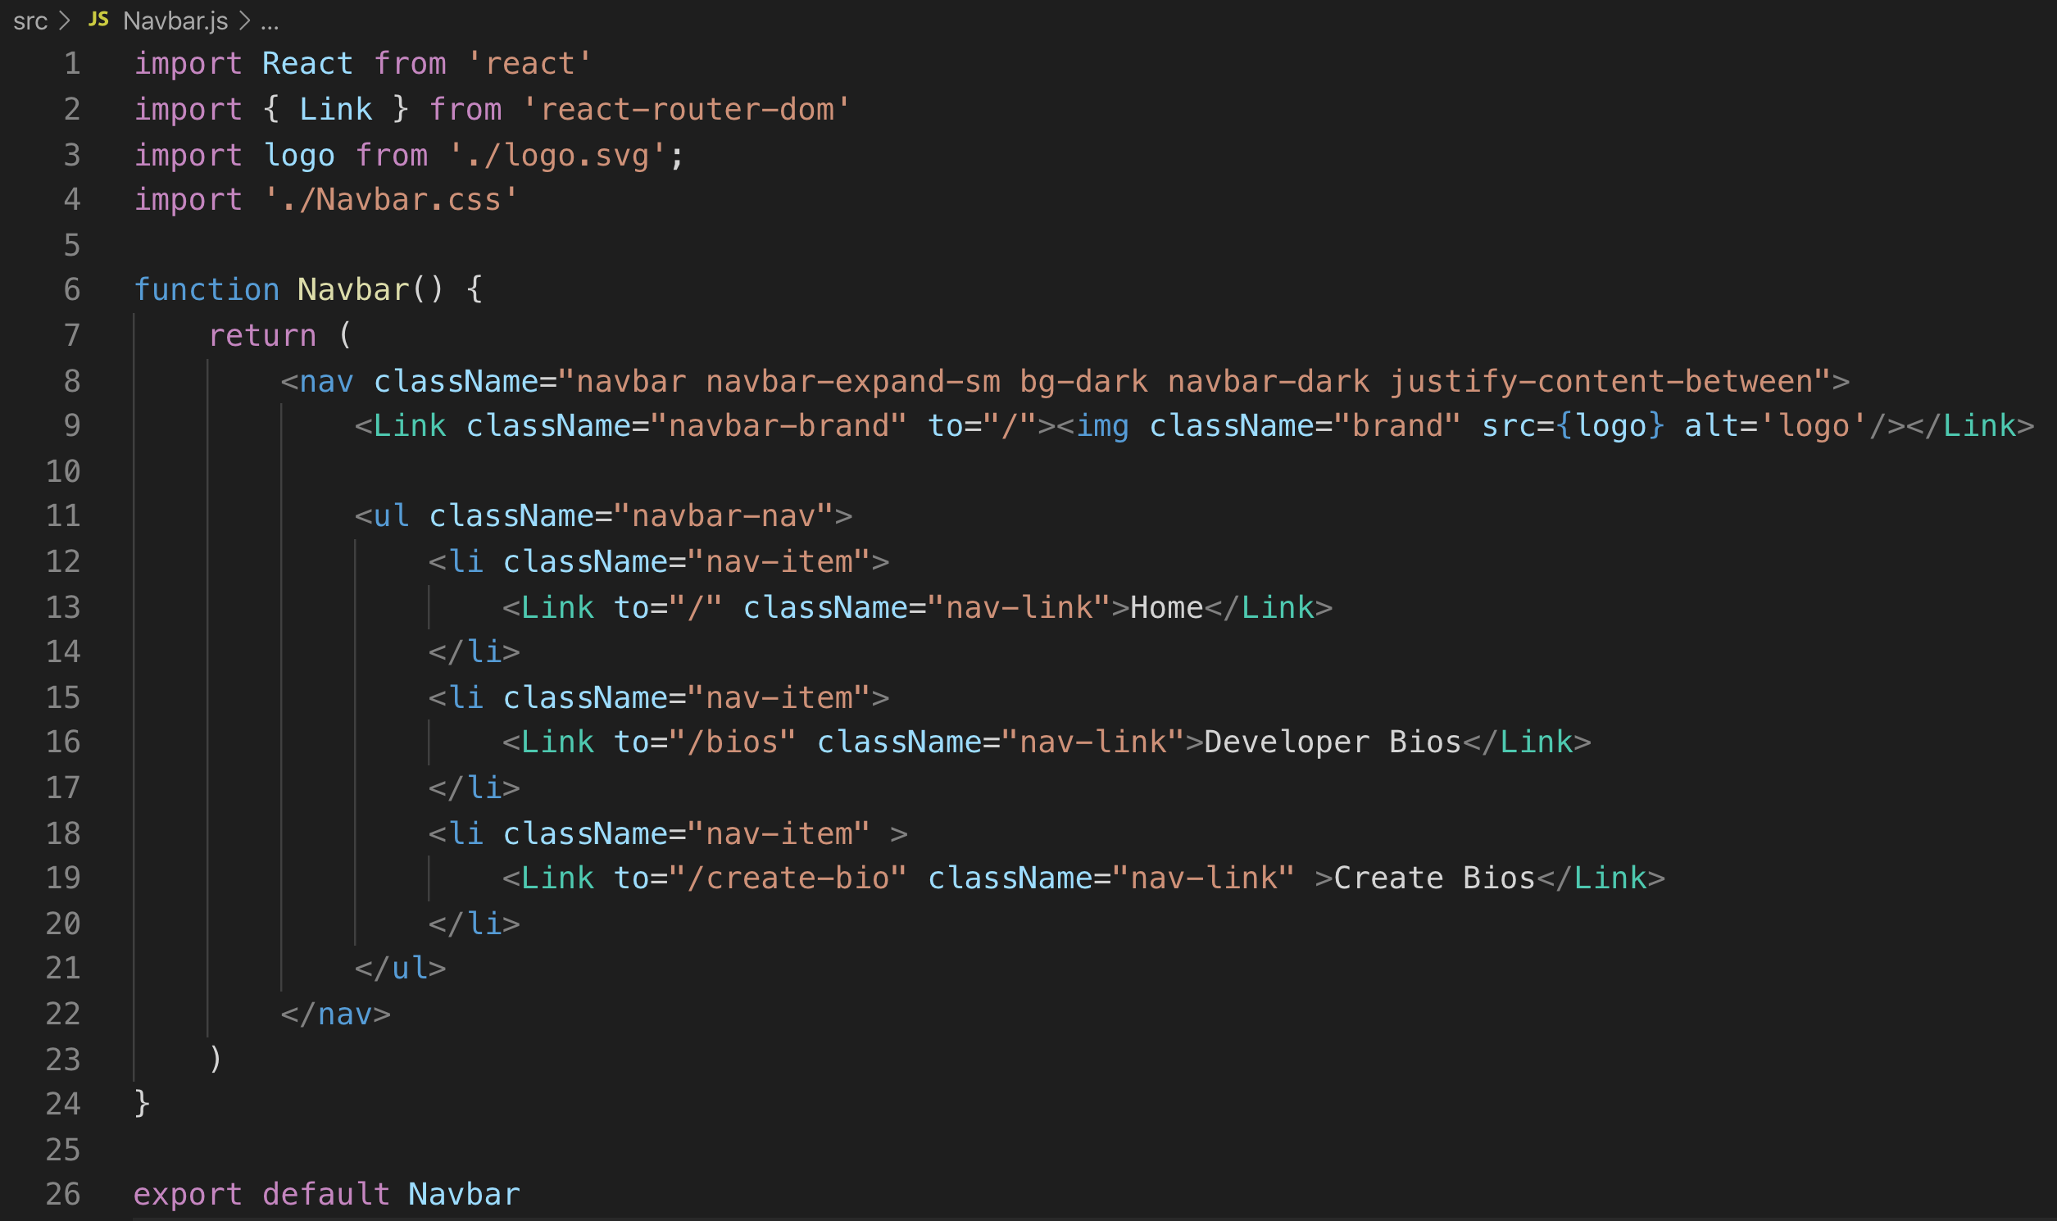
Navbar.js

Slide 17
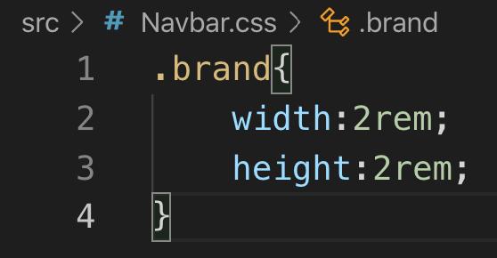
Navbar.css

Slide 18
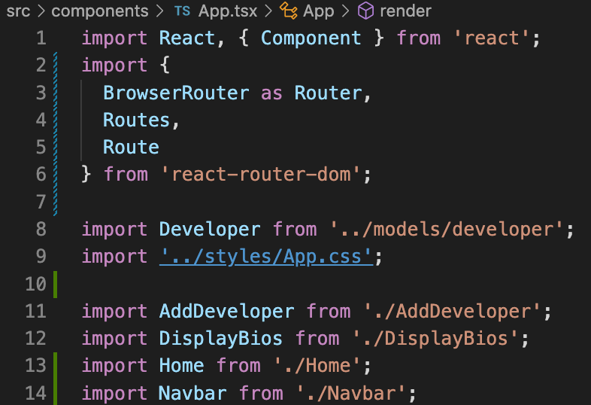
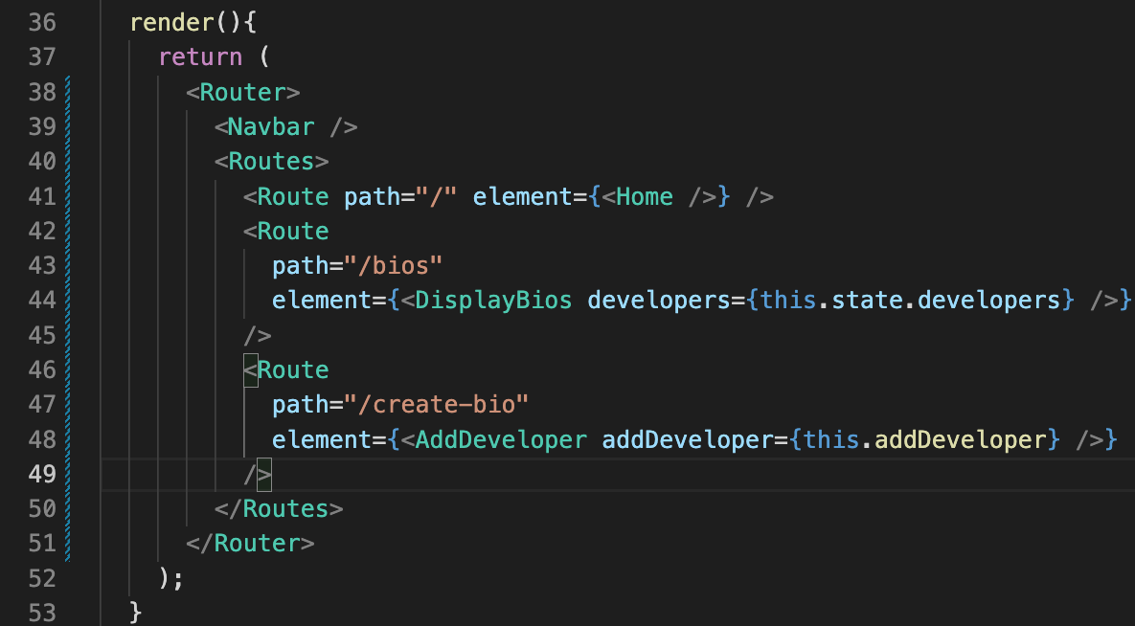
App.js

Slide 19
Redirects in React Router

Slide 20
Redirecting (<=v5)
It would be nice if our app redirected to developer bios page after a user submits a bio.
This can be accomplished using:
History
https://github.com/ReactTraining/history/blob/master/docs/navigation.md
withRouter
https://reacttraining.com/react-router/web/api/withRouter

Slide 21
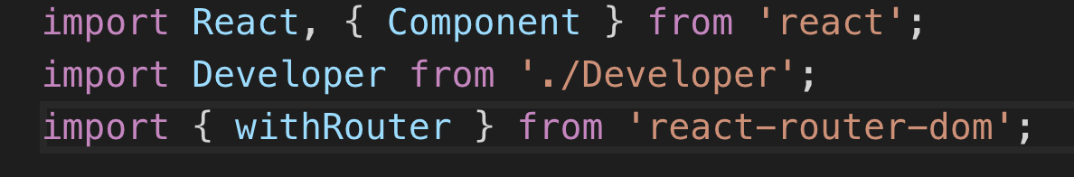
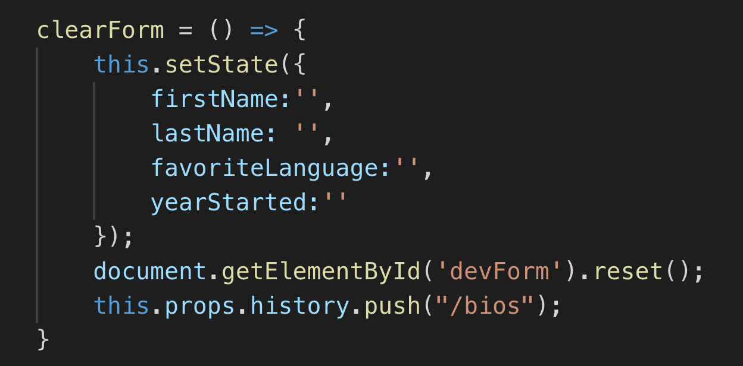
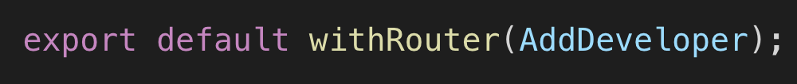
AddDeveloper.js

Slide 22
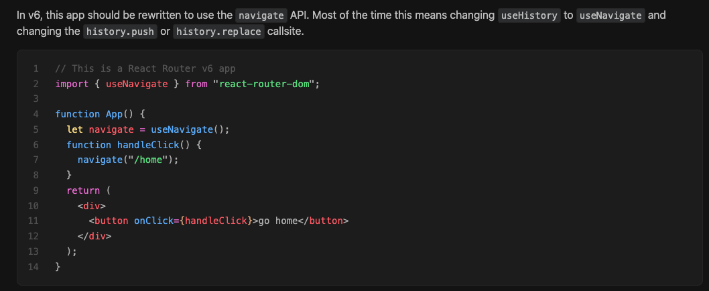
Redirecting (>v5)
HOC withRouter has been replaced with useNavigate hook. Only problem is that you can’t use Hooks inside of class components. We will revisit this redirect topic once we cover hooks and convert our AddDeveloper component to Hooks
https://reactrouter.com/docs/en/v6/upgrading/v5

Slide 23
Component Lifecycle Methods

Slide 24

Component Lifecycle Methods

Slide 25
Component Lifecycle
In applications with many components, it’s very important to free up resources taken by the components when they are destroyed.
We can declare special methods on the component class to run some code when a component mounts and unmounts. These methods are called “lifecycle methods”.

Slide 26
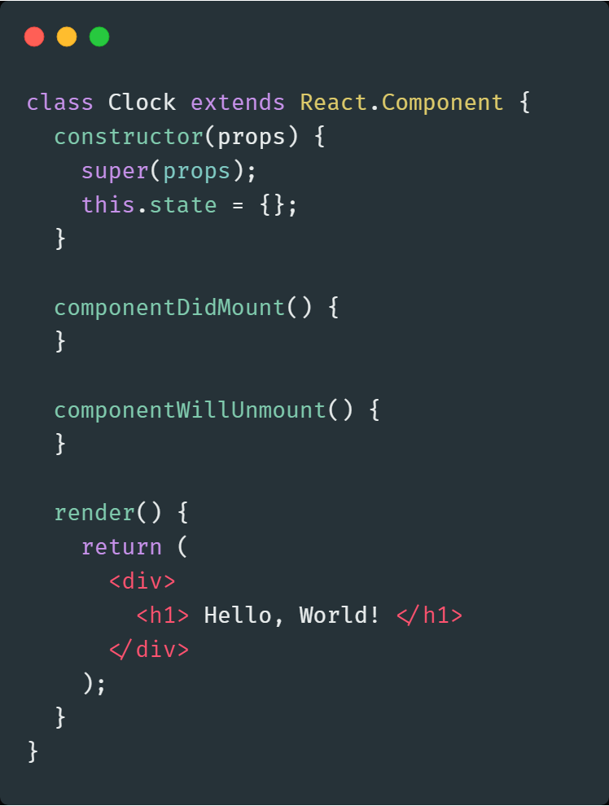
Component Lifecycle Methods
Constructor
ComponentWillMount
ComponentDidMount
ComponentWillReceiveProps
ShouldComponentUpdate
ComponentWillUpdate
ComponentDidUpdate
ComponentWillUnmount

Slide 27
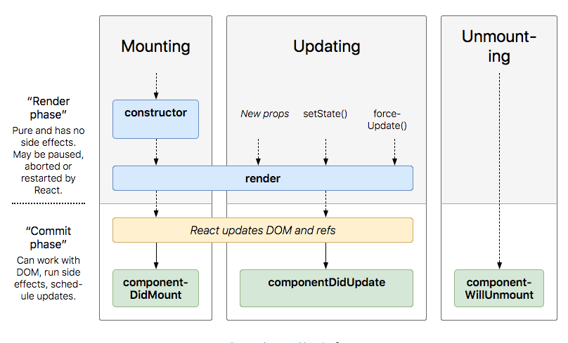

Slide 28
Commonly Used Lifecycle Methods
Constructor - It is called before component is mounted. Typically, in React constructors are only used for two purposes:
Binding event handler methods to an instance
Initializing local state by assigning an object to this.state.
componentDidMount() - Invoked immediately after a component is mounted.
Initialization that requires DOM nodes should go here.
Its a good place to set up any subscriptions. If you do that, don’t forget to unsubscribe in componentWillUnmount().

Slide 29
componentDidUpdate()
Invoked immediately after updating occurs.
This is also a good place to do network requests.
componentWillUnmount()
Invoked immediately before a component is unmounted and destroyed.
Perform any necessary cleanup in this method, such as invalidating timers, canceling network requests, or cleaning up any subscriptions that were created in componentDidMount().

Slide 30
Rarely Used Lifecycle Methods
shouldComponentUpdate()
Static getDerivedStateFromProps()
getSnapshotBeforeUpdate()
Legacy Lifecycle Methods
UNSAFE_componentWillMount()
UNSAFE_componentWillReceiveProps()
UNSAFE_componentWillUpdate()

Slide 31
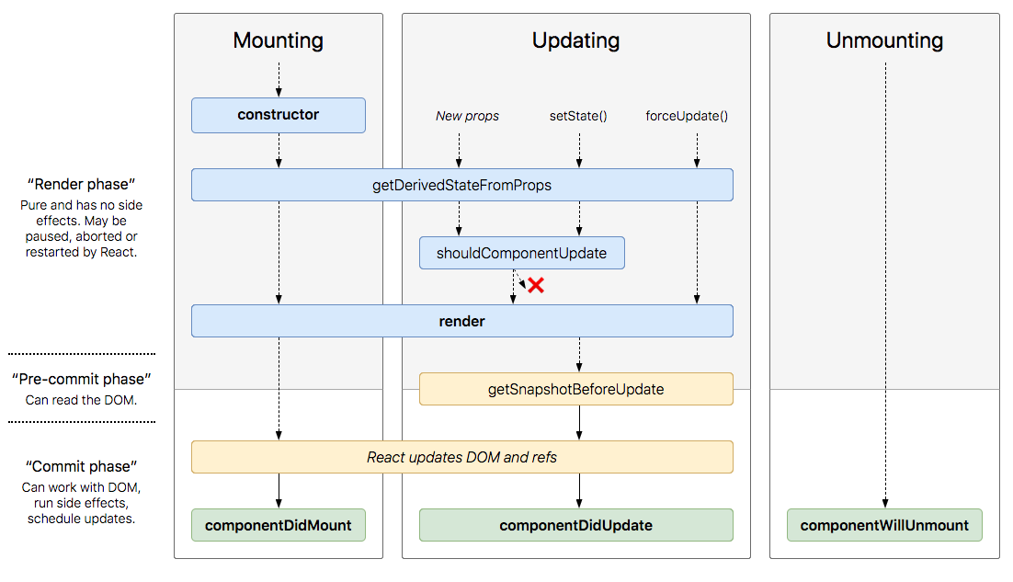

Slide 32
New Component Lifecycle
Mounting
A component is generally mounted when its first created and implanted into the DOM. It usually takes place when it is rendered for the first time.
Updating
An update can be caused by changes to props or state
Unmounting
This method is called when a component is being removed from the DOM
Error Handling
These methods are called when there is an error during rendering, in a lifecycle method, or in the constructor of any child component.

Slide 33
New Component Lifecycle (Contd..)
Mounting
constructor(), static getDerivedStateFromProps(), render(), componentDidMount()
Updating
static getDerivedStateFromProps(), shouldComponentUpdate(), render(), getSnapshotBeforeUpdate(), componentDidUpdate()
Unmounting
componentWillUnmount()
Error Handling
static getDerivedStateFromError(), componentDidCatch()

Slide 34
Fetching from Remote Repository

Slide 35
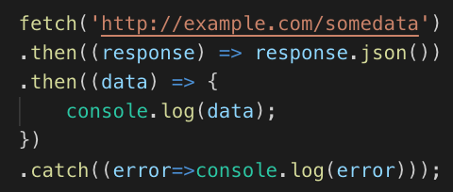
Fetch API
fetch function executes GET request to supplied endpoint
then function can chain together additional actions
Response must be processed (cast to json)
Data can then be used
catch used to handle errors
https://developer.mozilla.org/en-US/docs/Web/API/Fetch_API/Using_Fetch

Slide 36
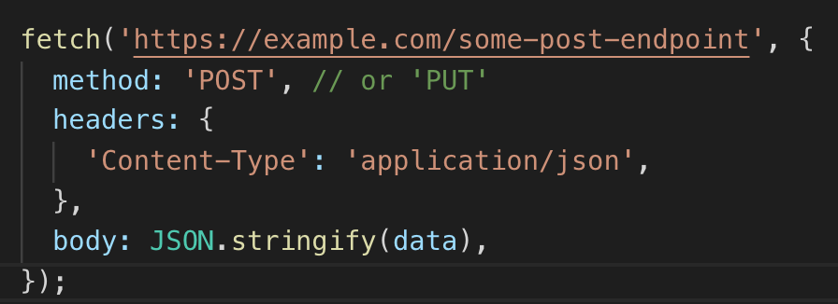
Fetch API - POST
Supply an object as a second parameter to issue POST or PUT
Method, Headers and body can be object properties
Many other properties available
https://developer.mozilla.org/en-US/docs/Web/API/Fetch_API/Using_Fetch

Slide 37
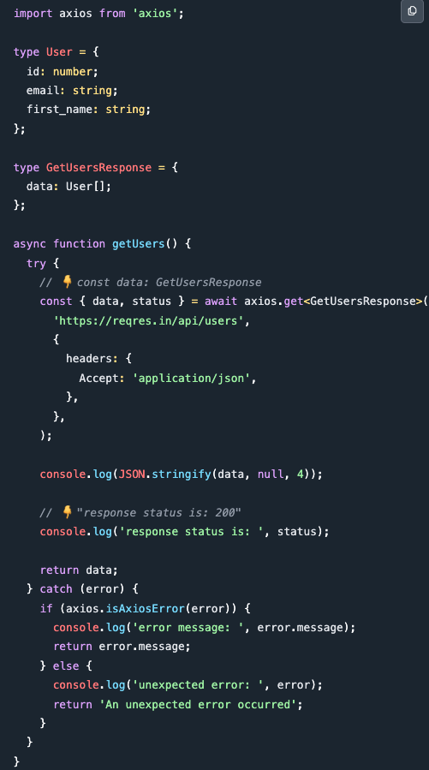
Axios API
https://bobbyhadz.com/blog/typescript-http-request-axios

Slide 38
Code Along Practice – Hit Live API for Developers
Add fetch to App.js in componentDidMount() hook which accesses https://tech-services-1000201953.uc.r.appspot.com/developers and sets developer state to the response. Delete the hard-coded developers from the state.
Add fetch with post object to submitForm() in AddDeveloper.js and change addDeveloper prop call to a regular variable. The post endpoint is the GET endpoint with the ‘s’ removed: https://tech-services-1000201953.uc.r.appspot.com/developer
*Optional - Delete addDeveloper from App.js and remove the prop from <AddDeveloper />

Slide 39
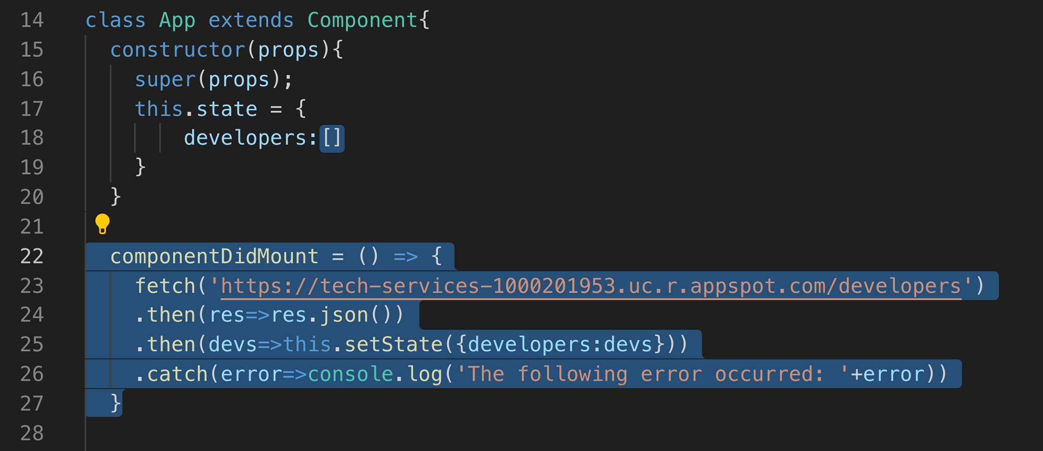
#1 App.js

Slide 40
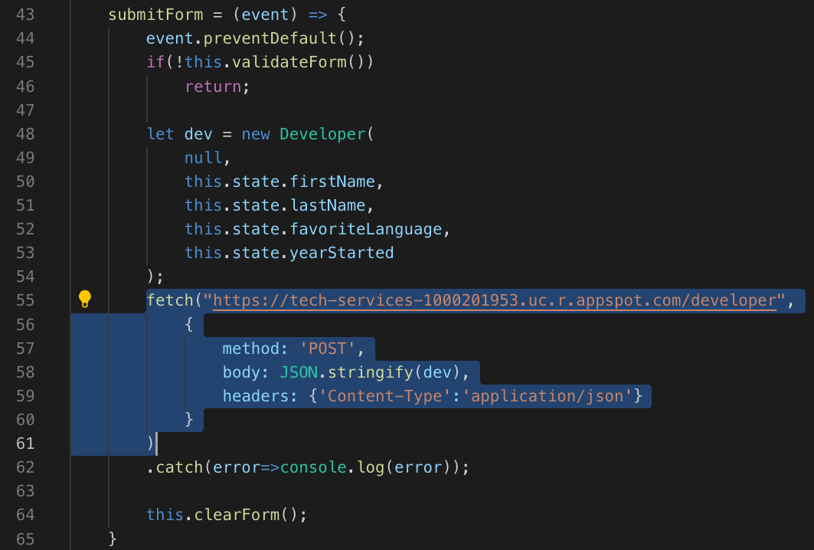
#2. AddDeveloper.js

Slide 41
Recap Of Routing
Routing is an important part of any application.
There are many routers available to be used with React.
Important one is React Router.
It helps us to create Single Page Applications with dynamic Routing.
Install react-router library to render it’s functionality.
<Router> contains all the routes, defined by <Route>
When a path matches path of <Route>, it returns the component.
<Link> provides navigation.
<HashRouter> contains classic URLs with hash.
<BrowserRouter> uses History API.

Slide 42

Practice Check
__________ means that routing takes place as app is rendering ?
Static Routing
React Routing
Dynamic Routing
None of the above
Name the properties that <Route > component takes:
to , component
pathname, to
to , render
path, element
Which component wraps all of the routes in react app using react-router (>=v6)?
<Link>
<Route>
<Nav>
<Routes>

Slide 43
Quiz
Identify the life cycle method that can be used to stop a component update or re-render.
I componentWillUpdate()
II shouldComponentUpdate()
III componentDidUpdate()
I only
II only
I, II, and II
III only
5. Which method in a React Component is called after the component is rendered for the first time?
componentDidUpdate
componentDidMount
componentMounted
componentUpdated

Slide 44
Quiz
Which of the following is correct syntax for a button click event handler, foo?
<button onclick={this.foo()}>
<button onclick={this.foo}>
<button onClick={this.foo()}>
<button onClick={this.foo}>
What happens when you call setState() inside render() method?
Repetitive output appears on the screen
Maximum update depth exceeded (React limits to prevent infinite loops)
Duplicate key error
Nothing happens. Life goes on!
How do you write an inline style specifying the font-size:12px and color:red; in JSX?
style={{font-size:12,color:'red'}}
style={{fontSize:'12px',color:'red'}}
style={fontSize:'12px',color:'red'}
style={{font-size:12px,color:'red'}}

Slide 45
Review
Installing Routing
Import { BrowserRouter as Router}
<Router> <Route > <Link >
Component Lifecycle

Slide 46
Course Objective:
At the end this 120 min session, you will be able to
Implement routing in a React app
List the common Component lifecycle methods

Slide 47
What kind of apps may not use routing at all?
What are the benefits of routing?

Slide 48
Thank You

